Slide 1

WHITE HOUSE HUNGER CONFERENCE
FEEDBACK FROM
SOUTHERN NEVADA
Community Meeting Hosted by:
City of Las Vegas Councilman, Brian Knudsen and Chief Policy Advisor, Dorian Stonebarger
With Support from:
Three Square Food Bank
Catholic Charities
The Just One Project
The Culinary Academy of Las Vegas

Slide 2
WHITE HOUSE HUNGER CONFERENCE Community Meeting
The Biden-Harris Administration has launched an effort to end hunger and to increase healthy eating and physical activity by 2030 so that fewer Americans experience diet-related diseases.
This effort will include a White House Conference on Hunger, Nutrition, and Health in September 2022. At the conference, the Biden-Harris Administration will announce a strategy with solutions to these challenges and will encourage the public and private sectors to work together to transform the food and physical activity environments in the United States.
The strategy will be a road map to end hunger, improve nutrition and physical activity, and eliminate disparities.

Slide 3

WHITE HOUSE HUNGER CONFERENCE Community Meeting
PILLARS
3. Empower all consumers to make
& have access to healthy choices
Improve food access & affordability
2. Integrate nutrition & health
5. Enhance nutrition & food security research
4. Support physical activity for all

Slide 4
WHITE HOUSE HUNGER CONFERENCE Community Meeting
PILLARS
3. Empower all consumers to make
& have access to healthy choices
Improve food access & affordability
2. Integrate nutrition & health
5. Enhance nutrition & food security research
4. Support physical activity for all

Slide 5
WHITE HOUSE HUNGER CONFERENCE Community Meeting
PARTICIPANTS
PUBLC | PRIVATE/NON PROFIT
City of Las Vegas | Three Square
Clark County Government | Catholic Charities
Clark County School District | Culinary Academy
Southern Nevada Health District | The Just One Project
University of Nevada, Las Vegas | Helping Hands of Vegas Valley
Nevada Department of Agriculture | Nevada HAND
 | American Hearth Association

Slide 6
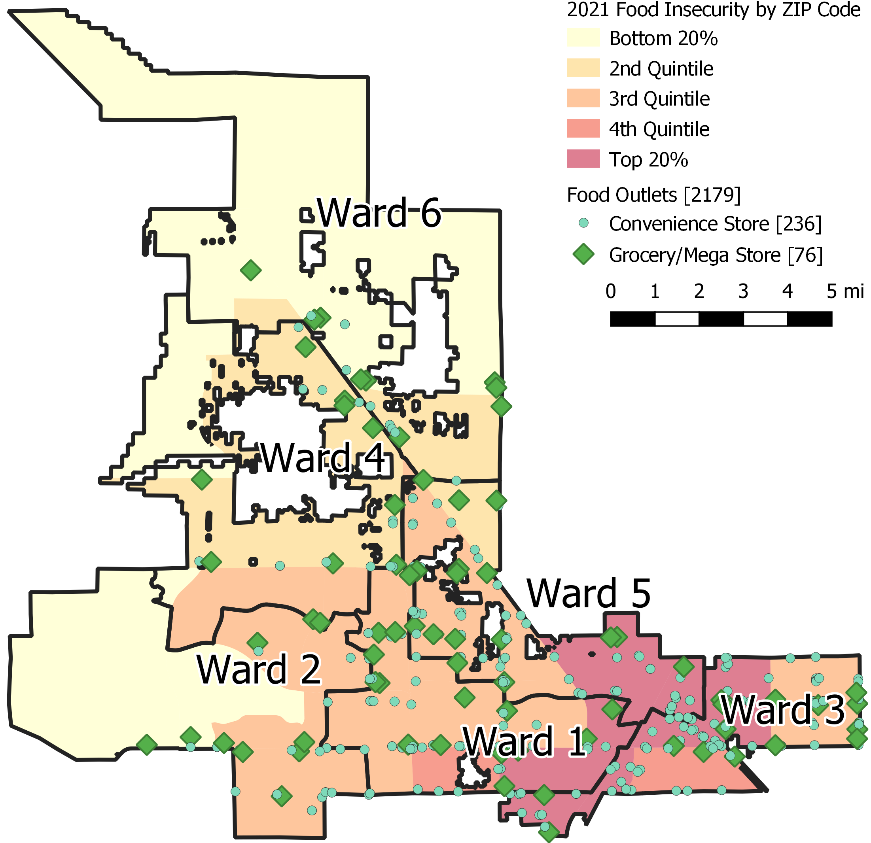
WHITE HOUSE HUNGER CONFERENCE Community Meeting
FOOD INSECURITY & FOOD ACCESS IN CLV
The proportion of persons who identify as Black or Hispanic is directly related to food insecurity rate.
Proximity to the urban core is directly related to food insecurity rate.
Ratio of convenience stores to grocers and megastores is higher in the urban core.

Slide 7
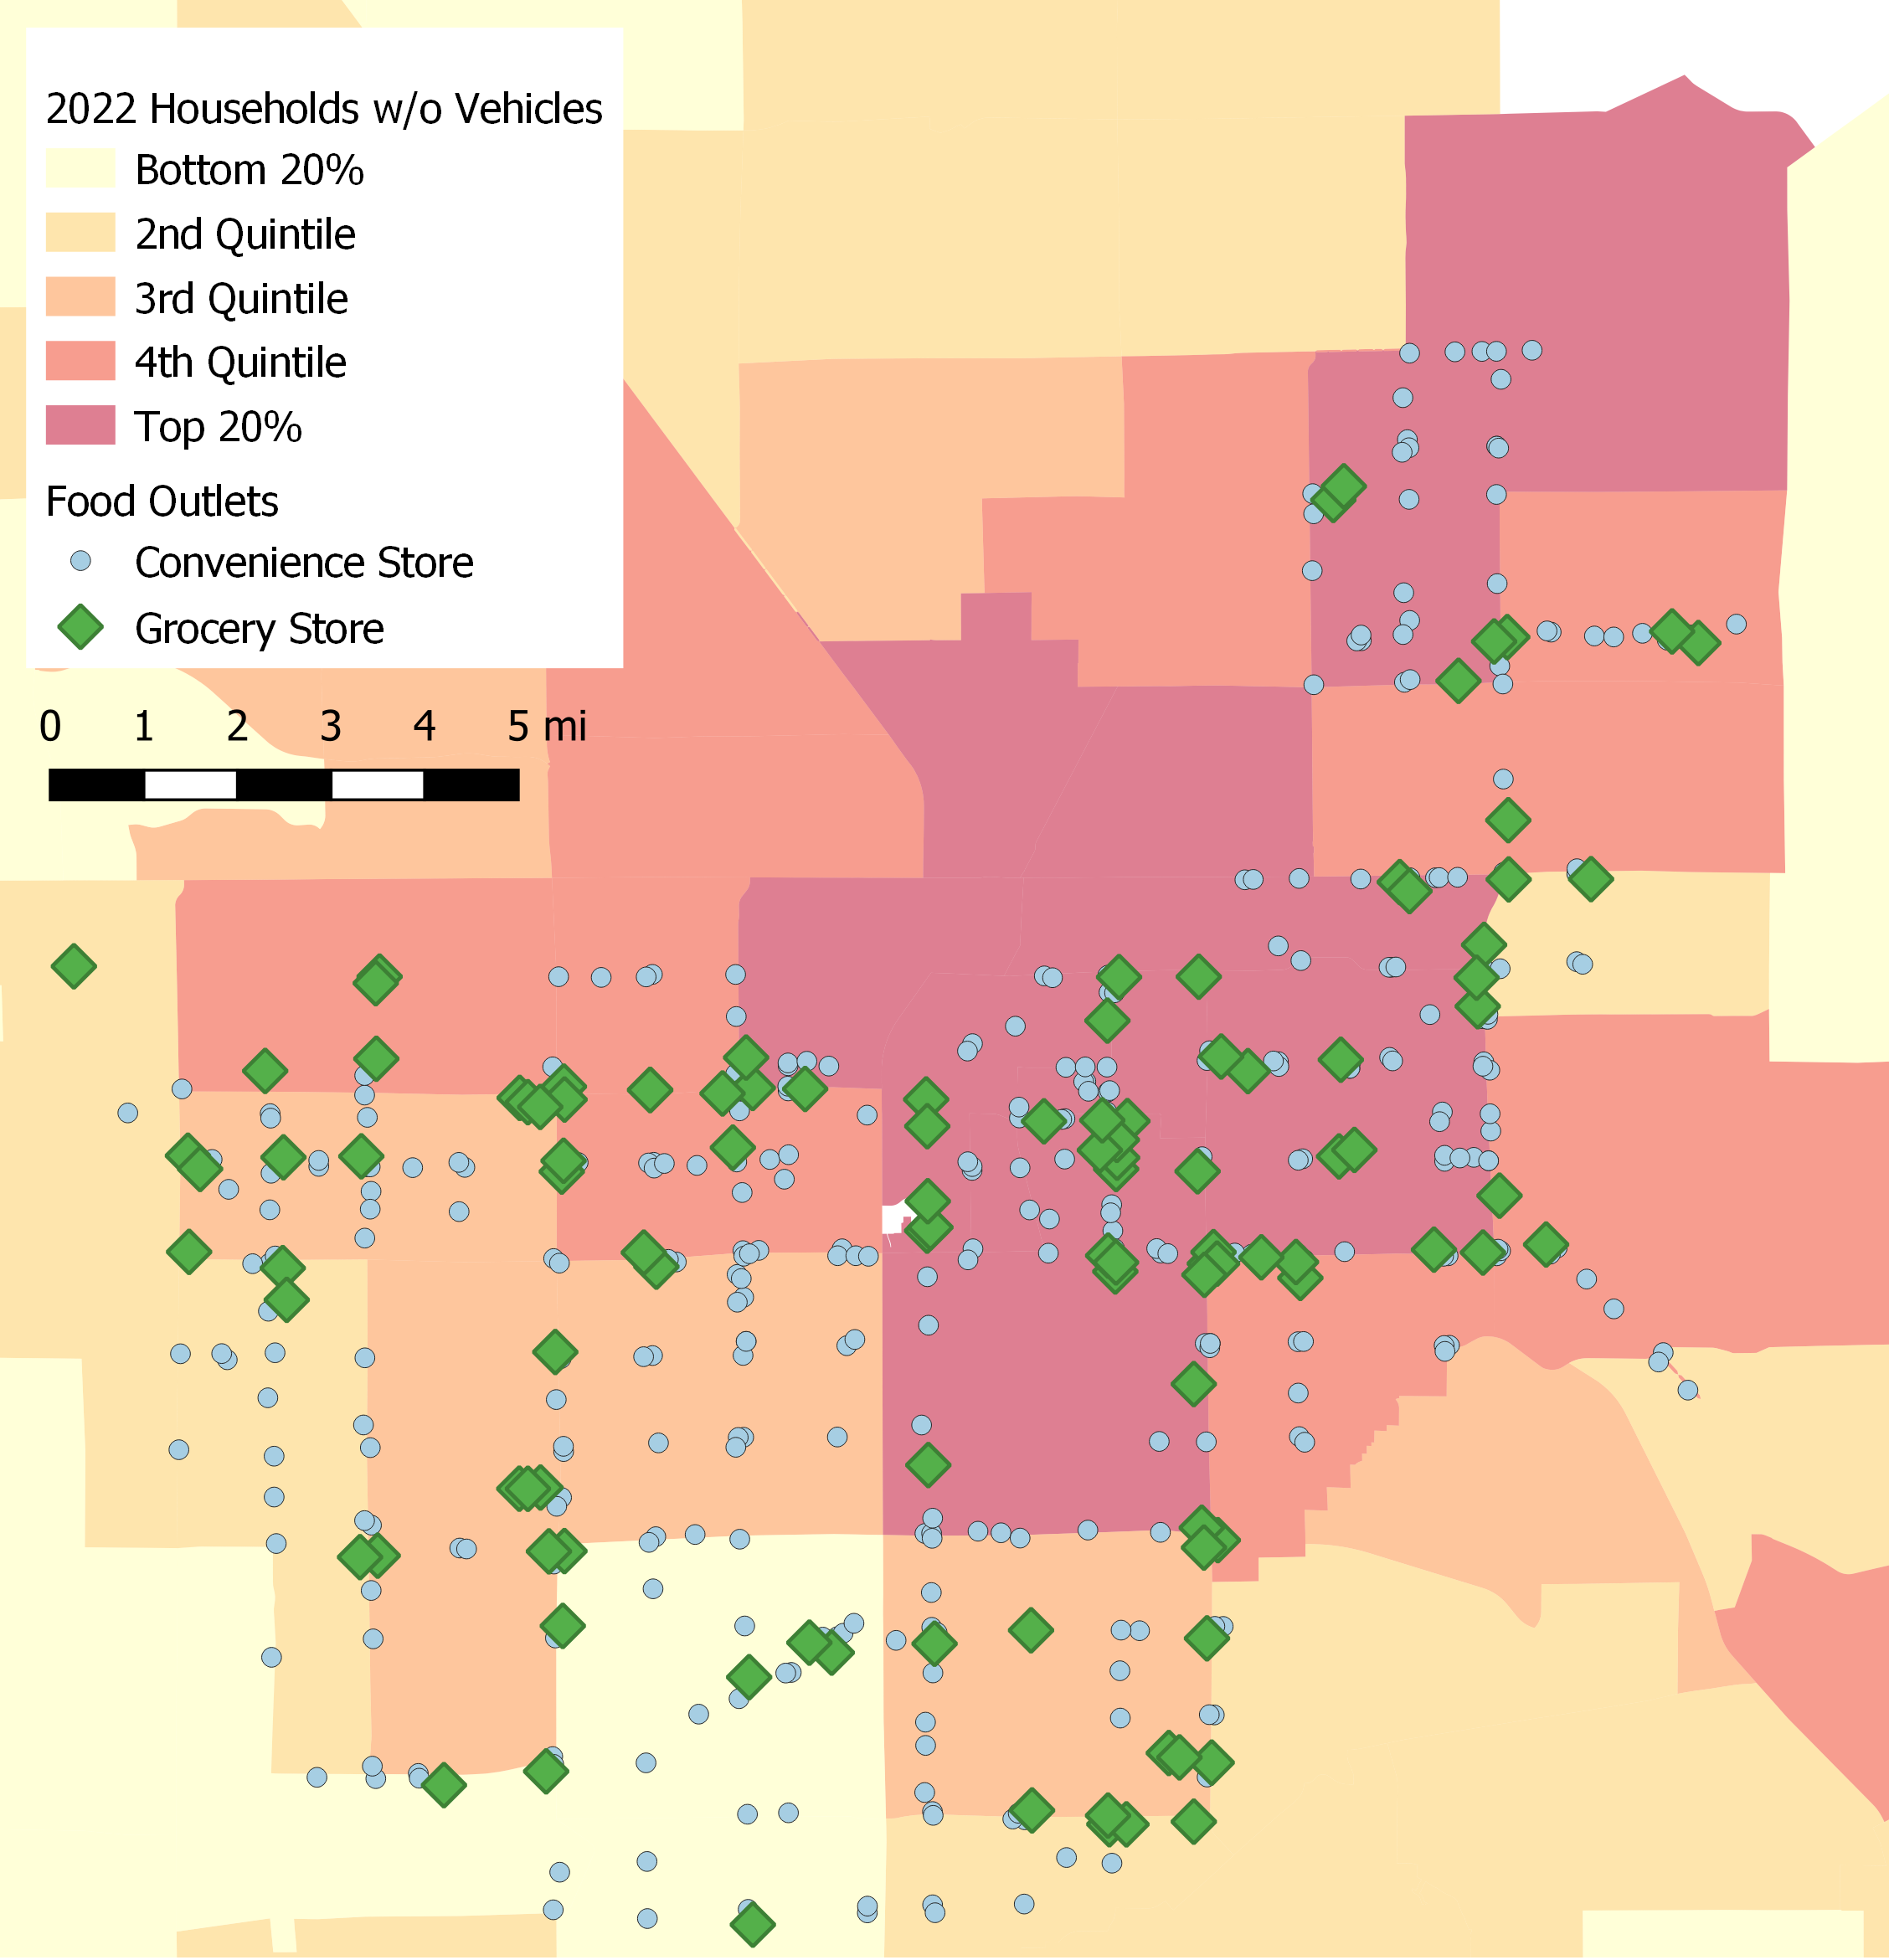
WHITE HOUSE HUNGER CONFERENCE Community Meeting
TRANSPORTATION & FOOD ACCESS IN CC
Proximity to the urban core is related to lack of household-level access to a vehicle.

Slide 8
WHITE HOUSE HUNGER CONFERENCE Community Meeting
Questions asked around IMPROVING ACCESS & AFFORDABILITY
1. What specific actions should the U.S. Federal government, including the Executive Branch and Congress, take to improve food access and affordability?
What are the opportunities and barriers to achieving the actions?
Actions should include specific policy and/or programmatic ideas and changes as well as funding needs.
2. What specific actions should local, state, territory and Tribal governments; private companies; nonprofit and community groups; and others take to improve food access and affordability?
3. What are opportunities for public- and private-sector partners to work together to improve food access and affordability?
4. What are innovative, successful activities already happening at the local, state, territory, and Tribal levels that could inform actions at the Federal level?

Slide 9
WHITE HOUSE HUNGER CONFERENCE Community Meeting
RESPONSES
1. What specific actions should the U.S. Federal government, including the Executive Branch and Congress, take to improve food access and affordability?
Senior Nutrition
  Nutrition guidelines, funding, definitions
Childhood Nutrition
  Waivers, Direct qualification expansion, Universal School Lunch
SNAP
  Eligibility, waivers, fresh food incentives

Slide 10
WHITE HOUSE HUNGER CONFERENCE Community Meeting
RESPONSES
1. What specific actions should the U.S. Federal government, including the Executive Branch and Congress, take to improve food access and affordability?
Other
  Decrease number of signatures needed for programs and allow electronic
  Invest in infrastructure and equipment for service programs (Capital needs)
  Incentives for healthy food providers
    Increase tax credit for healthy food providers
    Include convenience stores
  Allow Medicaid to cover food
    Part of health and wellbeing

Slide 11
WHITE HOUSE HUNGER CONFERENCE Community Meeting
RESPONSES
2. What specific actions should local, state, territory and Tribal governments; private companies; nonprofit and community groups; and others take to improve food access and affordability?
Mobile Distributions
  Increase/create funding stream specific to mobile distributions
Transportation
  Rally community groups and businesses around policies and placement of public transportation
Small Farms/Community Gardens
  Language, funding & education, partnerships, and subsidies

Slide 12
WHITE HOUSE HUNGER CONFERENCE Community Meeting
RESPONSES
2. What specific actions should local, state, territory and Tribal governments; private companies; nonprofit and community groups; and others take to improve food access and affordability?
Federal
  Make programs easier to participate in by removing regulations on the front end
    Keep monitoring and compliance at state and local level but shift the focus to serving more individuals and intent of meal programs
  Maintain COVID Waivers for SNAP and Childhood Nutrition Programs
  Invest in community access assessments
    Zip Code too broad

Slide 13
WHITE HOUSE HUNGER CONFERENCE Community Meeting
RESPONSES
2. What specific actions should local, state, territory and Tribal governments; private companies; nonprofit and community groups; and others take to improve food access and affordability?
State
  Create a job at the district level that focuses on pantries and share tables
  Education and outreach to increase participation
Local
  Improve Food Rescue
    Emphasize Community rescue – direct store pickup
    Expand banquet food rescue
      Form coop –expensive
    Improve packaging by incentivizing casinos to do smaller pkg & better looking (presentation)
  Composting program to support local farms
  Ensure SNHD guidelines for Federal Nutrition programs meet the intent

Slide 14
WHITE HOUSE HUNGER CONFERENCE Community Meeting
RESPONSES
3. What are opportunities for public- and private-sector partners to work together to improve food access and affordability?
Ensure that land use does not produce the gap in access
  Meaning, what is allowed on any given site for a particular amount of miles
Motivate stores and restaurants to participate in fresh food sales and food rescue or other waste management by potentially penalizing those that don’t.
Encourage pathways for smaller groups
  Rural areas as ESA’s for TEFAP
  Rural and Tribal Farmers with procurement contract
Create a framework for companies to adopt schools
  for pantries and weekend food programs/outside school hours
  Teachers are purchasing food

Slide 15
WHITE HOUSE HUNGER CONFERENCE Community Meeting
RESPONSES
4. What are innovative, successful activities already happening at the local, state, territory, and Tribal levels that could inform actions at the Federal level?
Tribal Community food (Federal Level)
Mobile Food Distributions
School Gardens
Universal Free Breakfast
EBT & WIC online
Food Rescue
COVID Response
Complete Streets
Collaboration among community organizations

Slide 16
WHITE HOUSE HUNGER CONFERENCE Community Meeting
ANYTHING TO ADD?
1. What specific actions should the U.S. Federal government, including the Executive Branch and Congress, take to improve food access and affordability?
What are the opportunities and barriers to achieving the actions?
Actions should include specific policy and/or programmatic ideas and changes as well as funding needs.
2. What specific actions should local, state, territory and Tribal governments; private companies; nonprofit and community groups; and others take to improve food access and affordability?
3. What are opportunities for public- and private-sector partners to work together to improve food access and affordability?
4. What are innovative, successful activities already happening at the local, state, territory, and Tribal levels that could inform actions at the Federal level?

Slide 17
WHITE HOUSE HUNGER CONFERENCE
THANK YOU!
Forget anything? Email dstonebarger@lasvegasnevada.gov

